Slide 1

AT Command of HC-06
Installation of Arduino Pro Micro

Slide 2
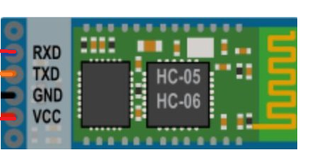
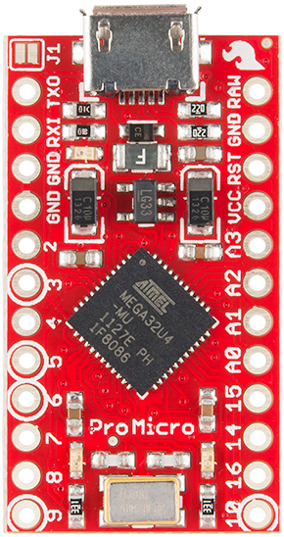
Step 1:
Wire up the connections as shown in the diagram.
Then connect the Arduino Pro Micro to your laptop via USB cable

Slide 3
Step 2:
Download and open up the AT_Command_HC-06 INO file
Link for AT Command INO File:
https://drive.google.com/open?id=0B0Yrf1mbmTaxVnVtMTdJaEhGOEE
Read the instructions written within /* */ before uploading the program
Refer to the next two slides for more information on AT Commands

Slide 4
AT Commands Instructions
AT Commands Available:
AT : check the connection
AT+NAME: Change name. No space between name and command.
AT+BAUDX: change baud rate, X is baud rate code, no space between command and code.
AT+PINXXXX: change pin, XXXX is the pin, again, no space.
AT+VERSION

Slide 5
Baudrate Avaliable:
To change baud rate, type AT+BAUDX, where X=1 to 9.
1 set to 1200bps
2 set to 2400bps
3 set to 4800bps
4 set to 9600bps (Default)
5 set to 19200bps
6 set to 38400bps
7 set to 57600bps
8 set to 115200bps
9 set to 230400bps

